Slide 1

Segment Tree
Anant Bansal and Dhruva Sarawgi
cyan

Slide 2
Problem:
Given an array of n elements: a₁, a₂, … a_{n}
Task
Query the sum of elements in range [l,r].
What if the required value of min of elements in range [l,r]? (or max, gcd, etc.)
Online updates at a given index?
Online updates in a range?

Slide 3

Starting from the basics: Range Queries
Given: 1. Array - a₁, a₂, … a_{n} 2. Q queries - (l₁, r₁), (l₂, r₂) … (l_{q}, r_{q})
A specific operation is given such as sum(+), xor(^), min, etc, and the task is to find the value of (a_{l} op a_{l+1} op … a_{r}) for the given queries of the form (l, r).
There can be two kinds of range queries:
Static (the underlying array stays the same) - EASIER, sometimes
Dynamic (elements of the underlying array may change over queries) - HARD

Slide 4
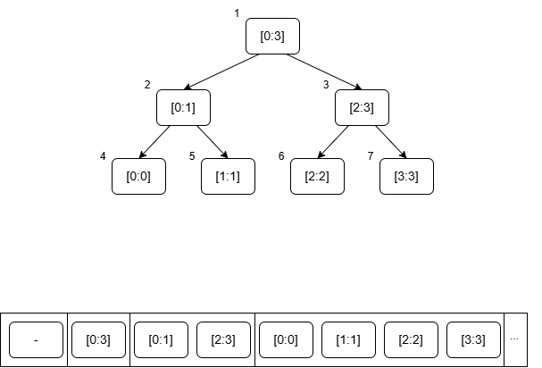
One kind of Segment Tree
Initialize: int seg[4*MAX_N];
Indexing: 1-based
0 1 2 3 4 5 6 7

Slide 5
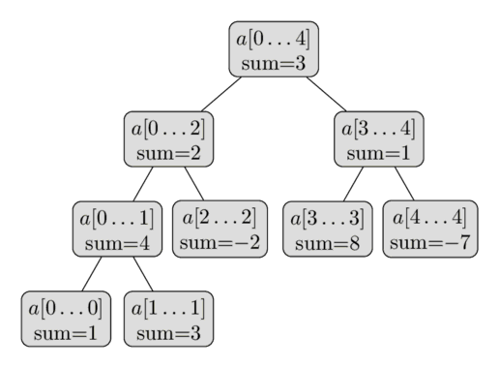
Structure of the Segment Tree:
Compute and store the sum of the whole array a[0:n-1]
Split the array into 2 halves and store their sums
so on…
Leaves are the individual elements a[i]
Eg a = [1, 3, -2, 8, -7]
Q: Height of the tree, given the length of array as n?
⎡log₂n⎤
Q: Upper bound on nodes in the segment tree, given the length of array as n?
4*n

Slide 6
Construction:
At each internal node, do the following steps:
recursively construct the values of the two child vertices
merge the computed values of these children
=> Call contructSegTree(1, 0, n-1, arr, n) to construct the tree.
void constructSegTree(int node, int l, int r, int arr[], int n):
if(l == r):
1.1 seg[node] = arr[l]
1.2 return
m = (l + r) // 2
constructSegTree(2*node, l, m, arr, n)
constructSegTree(2*node + 1, m + 1, r, arr, n)
seg[node] = combine(seg[2*node], seg[2*node + 1])

Slide 7
Query:
At each internal node, do the following steps:
check for overlap - none / partial / complete
No overlap - return a dummy value (0 for sum, LLONG_MAX for min)
Partial overlap - recursively call for values from left and right child -> combine and return
Complete overlap - return the value of segTree node itself as the answer
data query(int ql, int qr, int node, int l, int r):
if (ql > r or qr < l): // No overlap
return dummyValue (0 for sum)
if (ql <= l and qr >= r): // Complete overlap
return seg[node]
m = (l + r) / 2 // Partial overlap
val_l = query(ql, qr, 2*node, l, m), val_r = query(ql, qr, 2*node + 1, m + 1, r)
return combine(val_l, val_r)

Slide 8
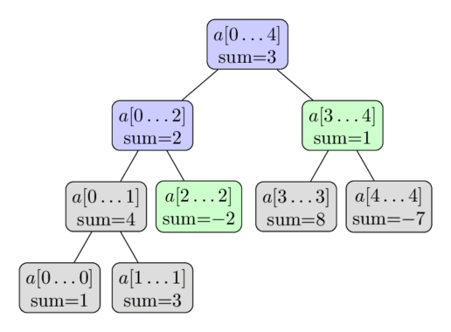
Query (Example Continued):
a = [1, 3, -2, 8, -7]
Calculate sum(a[2:4])
returns DummyValue

Slide 9
Update:
At each internal node, do the following steps:
If the node interval contains a single index, update the node
Update the left / right child based on which interval the update index belongs
Re-set the seg tree value at the current node based on children
void update(int upd_val, int upd_ind, int node, int l, int r):
if (l == r): // Single elem in node
seg[node] = upd_val
m = (l + r) / 2
if (m >= upd_ind) // Update index in left child
update(upd_val, upd_ind, 2*node, l, m)
else: // Update index in right child
update(upd_val, upd_ind, 2*node + 1, m + 1, r)
seg[node] = combine(seg[2*node], seg[2*node + 1])

Slide 10
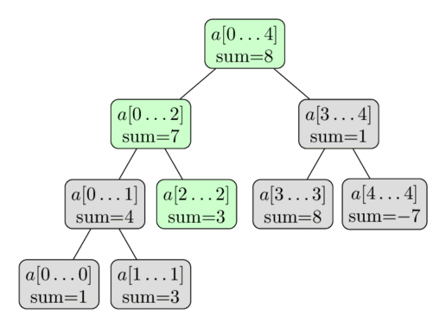
Update (Example Continued):
a = [1, 3, -2, 8, -7]
update a[2] = 3

Slide 11
Three things to think about:
Data: What data do you wanna store, and how do you want to initialize it.
Eg: Gcd, min, max, sum, XOR(^), OR(|), etc.
Combine: How to combine data from left child and right child.
Eg:
GCD: gcd(left, right)
min: min(left, right)
xor: left ^ right
Dummy value: If a node is visited that doesn’t overlap with the query interval, what val should be returned.

Slide 12
Questions
Given an array of n elements: a₁, a₂, … a_{n}; find max element and how many times it appears in the array. The updates are point updates.

Slide 13
Store data: pair<int, int> t[4*MAXN];
Combine step:
pair<int, int> combine(pair<int, int> a, pair<int, int> b) {
if (a.first > b.first)
return a;
if (b.first > a.first)
return b;
return make_pair(a.first, a.second + b.second);
}
Dummy: make_pair(-INF, 0);
Initialize: make_pair(a[l], 1);

Slide 14
Questions
Given an array of n elements: a₁, a₂, … a_{n}; find non-empty subarray with maximum sum and return the sum. The updates are point updates.
Note: A subarray is formed by removing 0 or more elements from the start and end of a given array.

Slide 15
Store data:
struct data {
int sum, pref, suff, ans;
};
Combine step:
data combine(data l, data r) {
data res;
res.sum = l.sum + r.sum;
res.pref = max(l.pref, l.sum + r.pref);
res.suff = max(r.suff, r.sum + l.suff);
res.ans = max(max(l.ans, r.ans), l.suff + r.pref);
return res;
}
Dummy: make_data(0);
Initialize:
data make_data(int val) {
data res;
res.sum = val;
res.pref = res.suff = res.ans = max(0, val);
return res;
}

Slide 16
Problem:
Given an array of n elements: a₁, a₂, … a_{n}
Task
Query the sum of elements in range [l,r].
What if the required value of min of elements in range [l,r]? (or max, OR, etc.)
Online updates at a given index?
Online updates in a range?

Slide 17
Range Update:
Instead of updating all elements immediately, store "pending updates" at segment nodes
Apply updates only when necessary (during query or propagation)
How to store pending updates?
Along with seg[4*MAX_N], use another array - lazy[4*MAX_N]
Lazy Array (lazy[4*MAX_N]):
Stores updates that haven’t been propagated yet
Updates are applied only when a node is visited

Slide 18
Propagate: (Example for sum)
Note: In propagate:
Check if there is a pending update, and if not, just return
Update the current node value based on the value of pending update in lazy array
Combine the lazy values of the children with the parent’s
Set the lazy value -> no pending update on current node
void propagate(int node, int start, int end):
if (!lazy[node]): return
seg[node] += (end - start + 1) * lazy[node]
if (start != end):
lazy[2 * node] += lazy[node]
lazy[2*node + 1] += lazy[node]
lazy[node] = 0

Slide 19
Update:
Note: Here propagate has to be called on children before combining, to apply pending updates to the children seg array values
void update(int upd_val, int ql, int qr, int node, int l, int r):
propagate(node, l, r)
if (ql > r or qr < l): // No overlap
return
if (ql <= l and qr >= r): // Complete overlap
lazy[node] = upd_val
Return
m = (l + r) / 2 // Partial overlap
update(upd_val, ql, qr, 2*node, l, m) // Update index in left child
update(upd_val, upd_ind, 2*node + 1, m + 1, r) // Update index in right child
propagate(2*node, l, m), propagate(2*node+1, m+1, r) // Apply pending updates on children
seg[node] = combine(seg[2*node], seg[2*node + 1])

Slide 20
Query:
data query(int ql, int qr, int node, int l, int r):
propagate(node, l, r)
if (ql > r or qr < l): // No overlap
return dummyValue (0 for sum)
if (ql <= l and qr >= r): // Complete overlap
return seg[node]
m = (l + r) / 2 // Partial overlap
val_l = query(ql, qr, 2*node, l, m), val_r = query(ql, qr, 2*node + 1, m + 1, r)
return combine(val_l, val_r)

Slide 21
Question
In an ancient treasure land, there lie a chest of gold coins, divided between 2 friends Raj and Arush. Each gold chest is not fixed, sometimes one can attack to take the other's chest. All of a sudden magic appeared on treasure land, where the owner of chest can be changed.
Given an array stating the owner of gold chests, 1-> Raj, 0 - > Arush
You are given following queries
R a b : change owner of chests from index a to b, to Raj
A a b: change owner of chests from index a to b, to Arush
I a b: inverse the owner of chests from index a to b
S a b: Tell how many gold chests from index a to b belong to Raj.

Slide 22
Further Readings:
References:
MergeSort Trees (Saving the entire subarrays in each vertex)
Persistent Segment Trees
2D segment trees
https://cp-algorithms.com/data_structures/segment_tree.html
https://codeforces.com/blog/entry/18051
https://codeforces.com/edu/courses

Slide 23
Practice Problems:
https://cp-algorithms.com/data_structures/segment_tree.html#practice-problems
https://codeforces.com/blog/entry/22616

